Slide 1
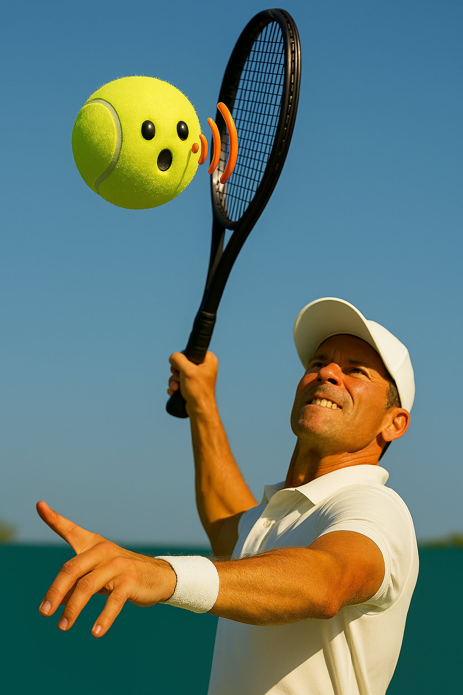
Final presentation SmartServe Ball
Casper Blok, Ricardo Salas, Noah Vastmans, Robin Wathelet

Slide 2
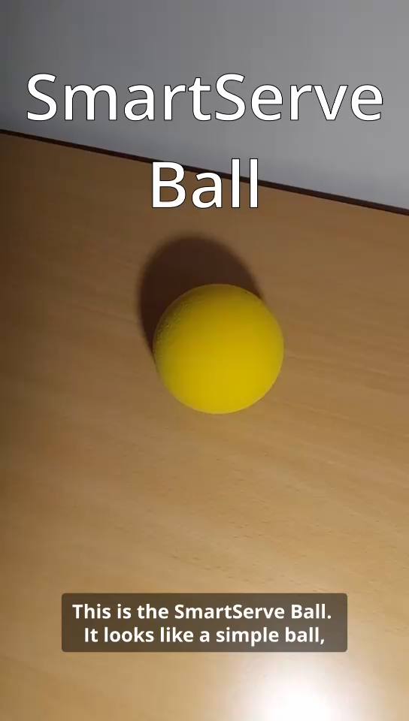
Video

Slide 3
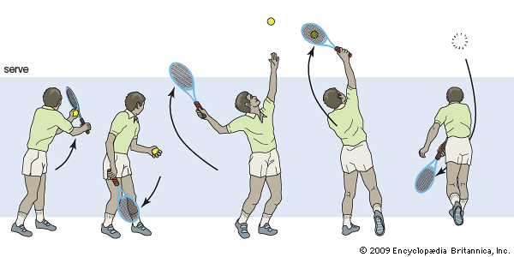
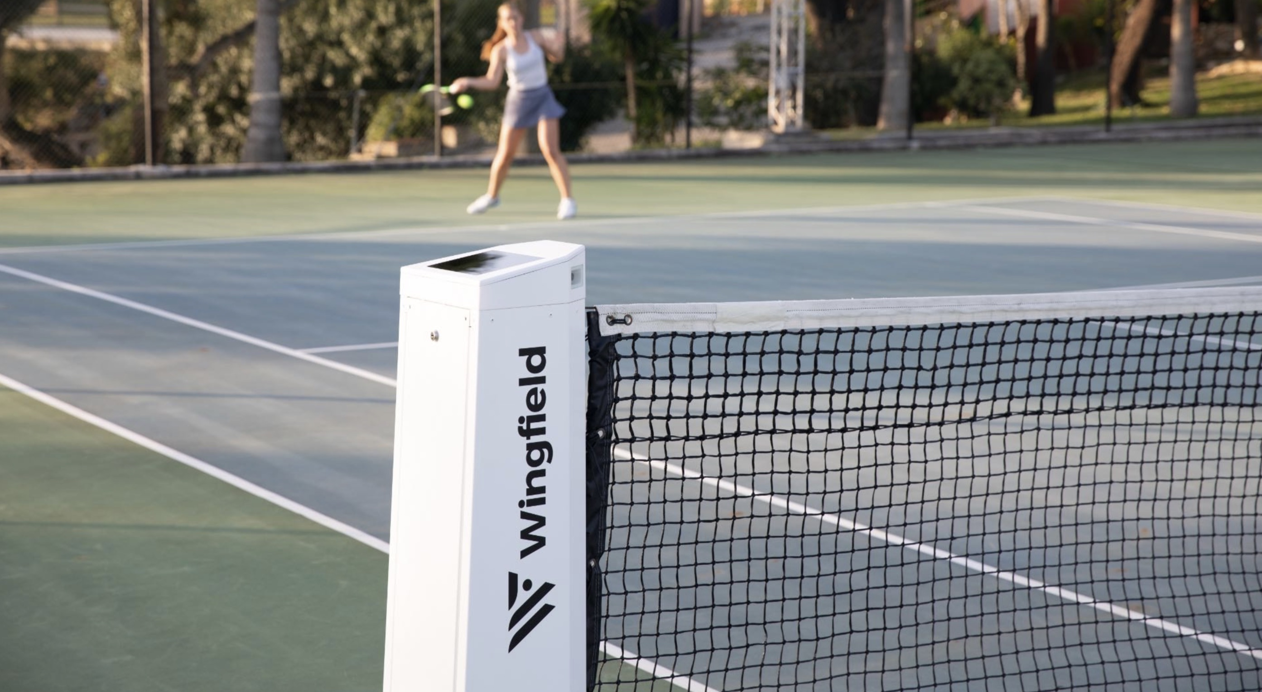
Problem Statement
Difficult evaluation of tennis serve timing
Alternative solutions:
Coach → unreliable
Video analysis → expensive setup

Slide 4
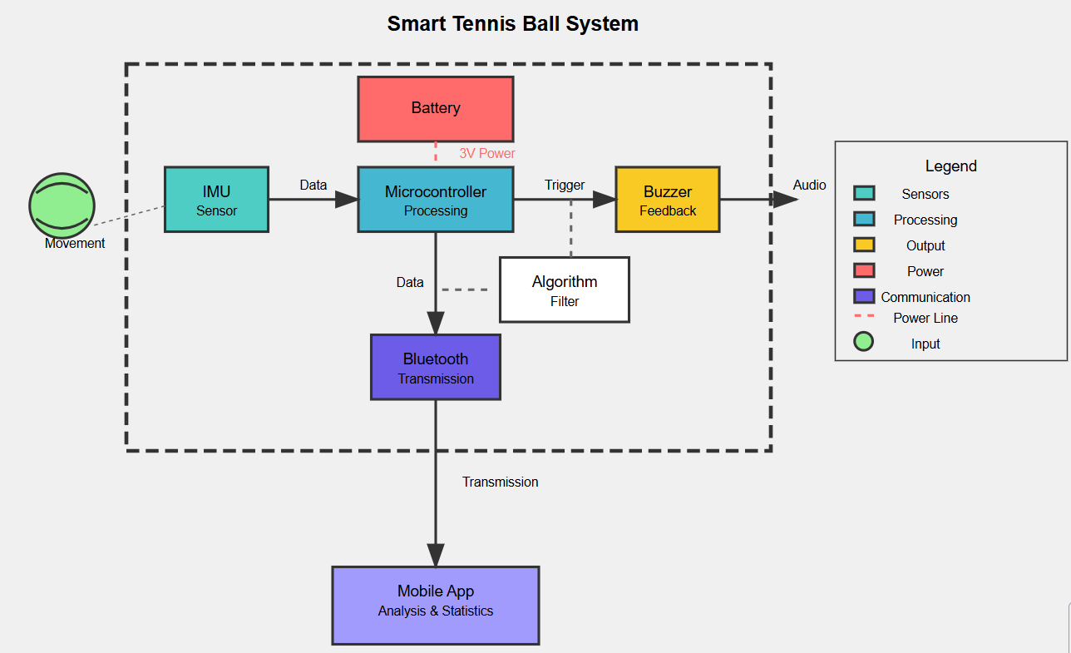
Technical design
Seeed Studio XIAO nRF52840 Sense board
IMU
Microcontroller
Bluetooth module
Integrated electrical circuit with buzzer and coin battery
Training foam ball

Slide 5
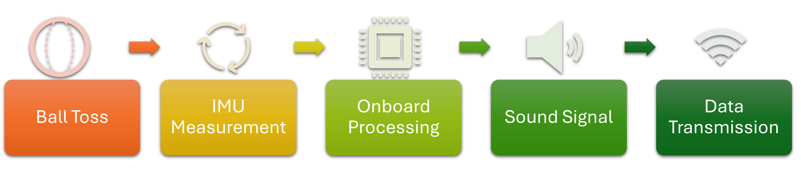
Technical design
Velocity reconstruction from acceleration
Freefall detection: flight time
Apex detection → trigger acoustic feedback

Slide 6

User Interaction
Simple Setup
Real Time Feedback
Reduce training costs
Progress tracking

Slide 7
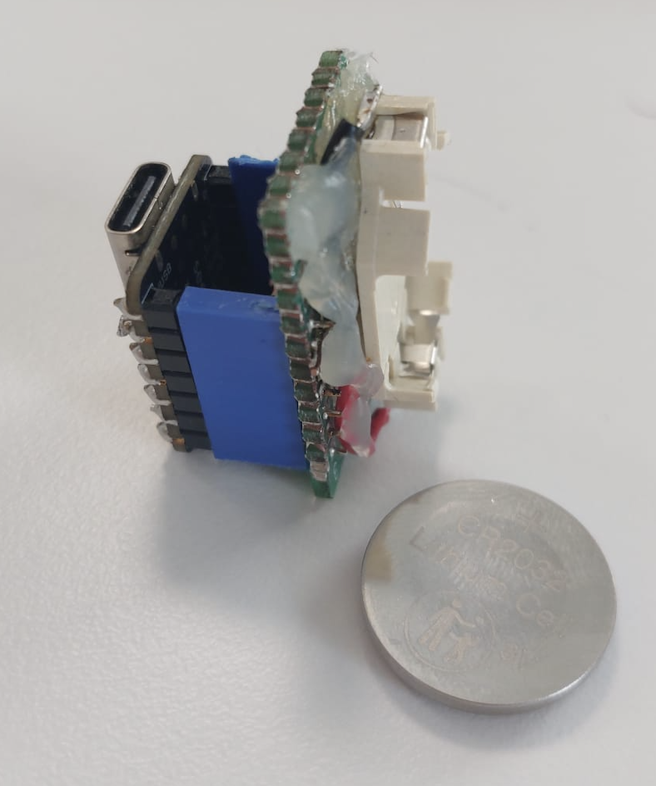
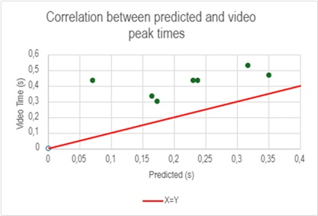
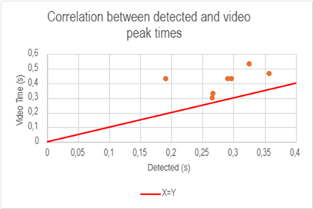
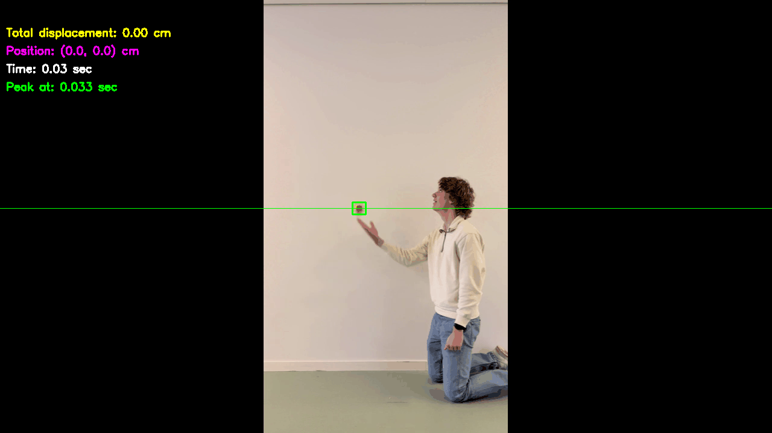
Results
Prototype works
Bluetooth streaming
Buzzer
Mean error (based on 7 test throws)
Predicted vs Video:- 47.7% ( −0.19 seconds)
Detected vs Video:-30.5% (−0.13 seconds)
Higher throws are better

Slide 8
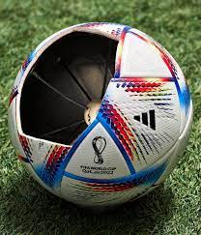
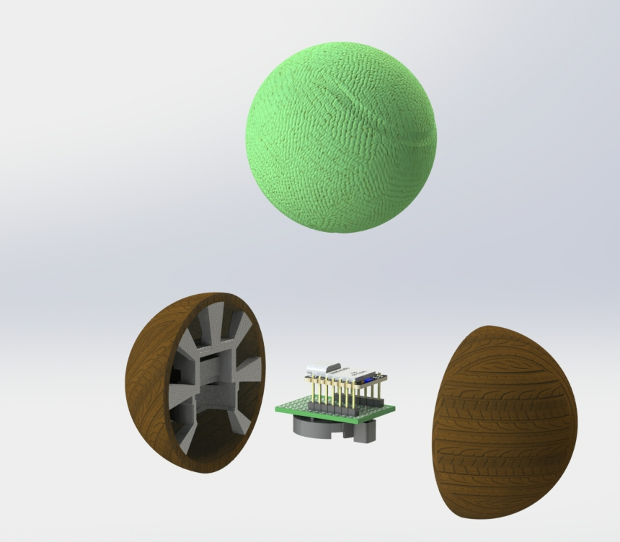
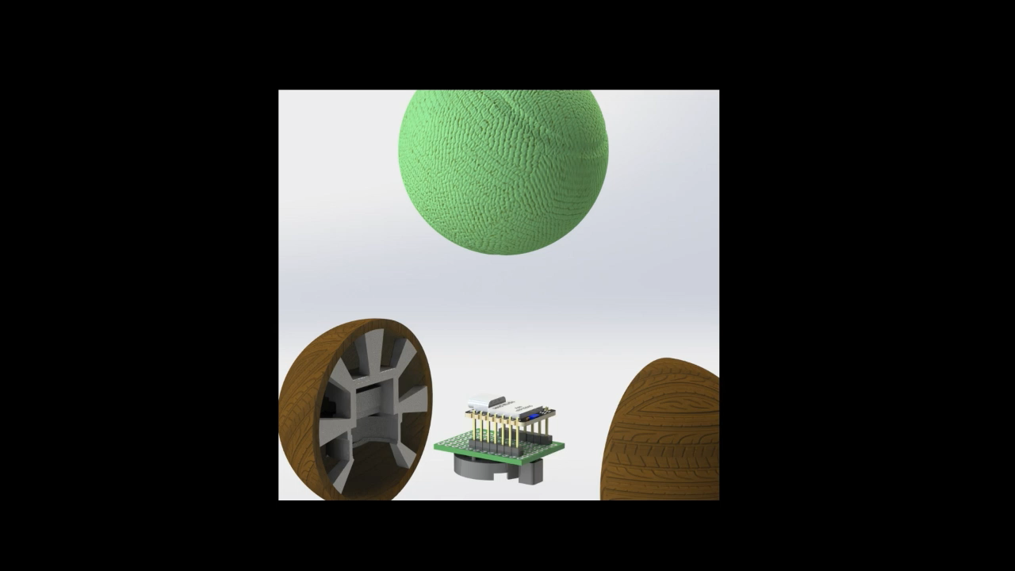
What's next
Integration into a real tennis ball
Provide sufficient integrity
Center of rotation
Affect minimal initial properties
Weight
Balance
Elasticity
Improve accuracy
Both detection and video validation
Onboard data storage → delayed transmission
App design for progress tracking

Slide 9
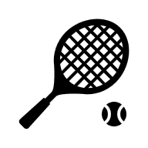
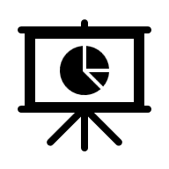

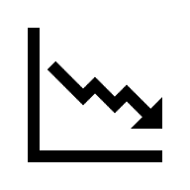
Other Uses
Tennis
Digitali-zation
Expanding to other strokes
Custom Performance Indicators
Sports
Research
Cost Effective tool for Research
Transferability to Other Sports
Ball Kinematics Characterization
Athletes' response to audio base training feedback
Motion analysis and prototype testing

Slide 10
Project Methodology
The group dynamic is centered around an open table discussion.
Brainstorming
Collectively discuss ideas
Parallel work
Positive
Weekly meetings
Strong communication
Leasons learned
More communication between members about their work
Seeking help at an earlier stage when stuck

Slide 11
Thank you for your attention! Questions?

